Slide 1

Mitron Bank Analysis Dashboard Power BI
Prepared by: Vishal Rathore
Roll No. IA00940
Summary of operational insights from Mitron Bank Ddataset.

Slide 2
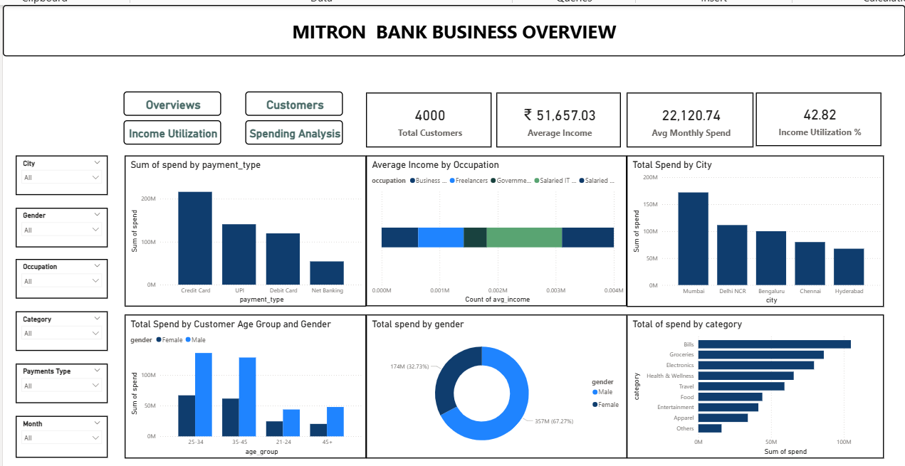
MITRON BANK BUISNESS

Slide 3
Key KPIs
Utilization Rate: 42.82%
Total Customers: 4,000
Average Income: ₹51,657
Avg. Monthly Spend: ₹22,120
Utilization Rate: 42.82%
Observation: Credit Cards are the leading payment method (₹216M), significantly outperforming UPI and Debit Cards.
Analyst Insight: The high average income suggests a customer base with significant purchasing power, but a 42% utilization rate indicates room to grow credit limits for top-tier spenders.

Slide 4
Customer Demographics Classification
Age Group Breakdown: The 25-34 age group is the largest segment, followed by 35-45.
Gender Analysis:
Male: 64.93% (2.6K customers)
Female: 35.08% (1.4K customers)
Geographic Distribution: Mumbai is the primary hub, followed by Chennai and Bengaluru.
Analyst Suggestion: Targeted marketing should focus on the 25-34 demographic in Mumbai, as they represent the highest volume of potential credit card users

Slide 5
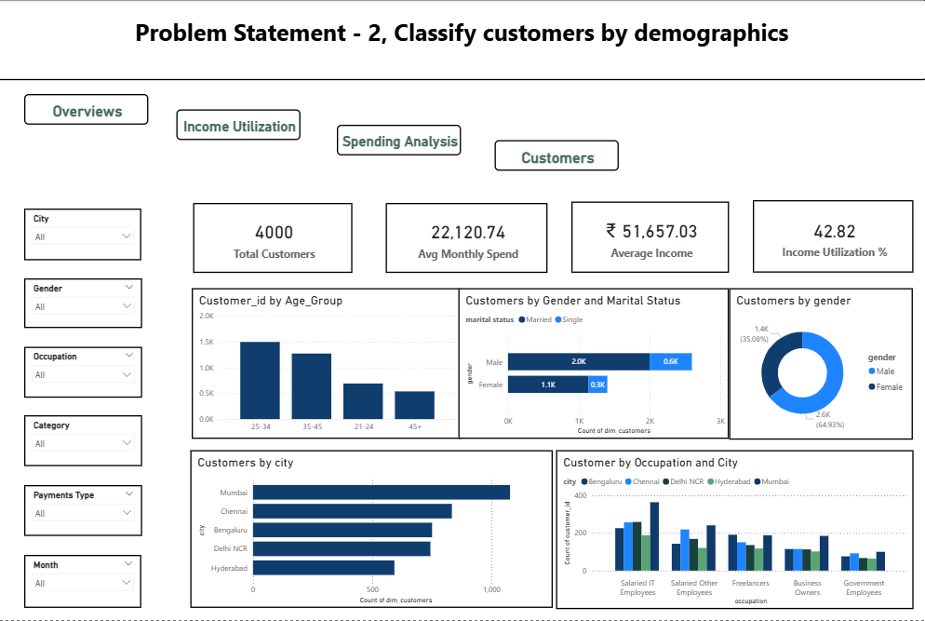
Classify Customers by Demographics

Slide 6
Average Income Utilization Analysis
Top Performers: Salaried IT Employees have the highest utilization (21.6% for married, 20.0% for single).
Marital Status Impact: Across almost all categories (IT, Freelancers, Business Owners), married customers utilize more of their income than single customers.
Analyst Suggestion: Create a "Family Rewards Program" or "Household Expense" card tier specifically for married IT professionals to capture more of their high-utilization spending.

Slide 7
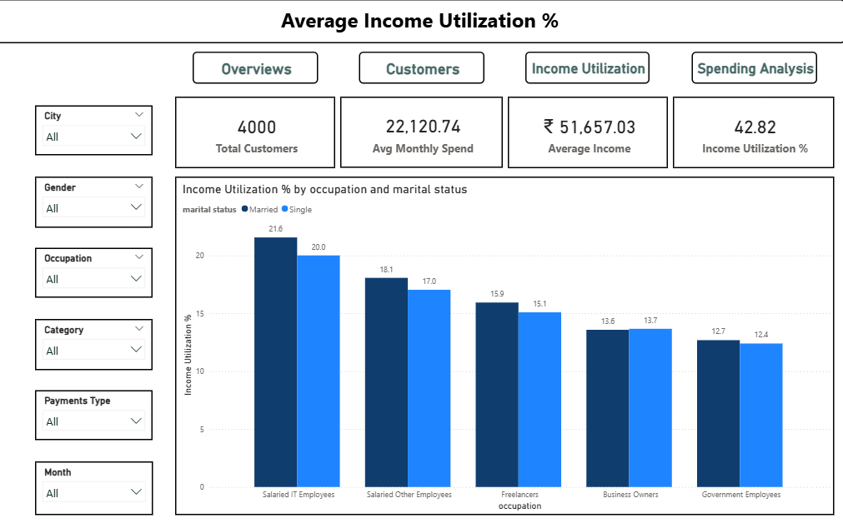
Average Income Utilization Analysis

Slide 8
Spending Pattern Analysis
Top Spend Categories:
Bills: ₹105M
Groceries: ₹86M
Electronics: ₹80M
Monthly Trends: Spending peaks in September (₹116M) and August (₹101M), likely due to festive season shopping in India.
Analyst Suggestion: * Launch high-reward "Festive Cashback" campaigns in August.
Implement "Auto-Bill Pay" rewards to secure the #1 spending category (Bills).

Slide 9
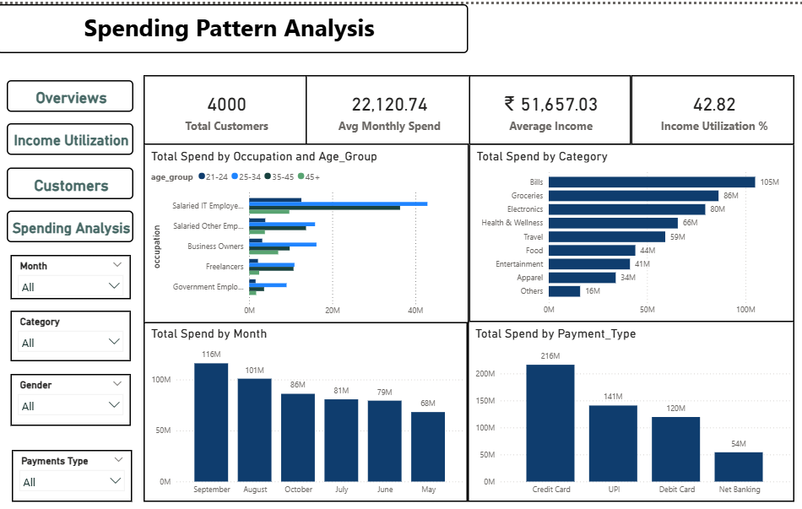

Slide 10
Data Analyst Recommendation
To maximize growth, Mitron Bank should launch a Co-branded Credit Card with a major electronics or grocery retailer, specifically targeting Salaried IT professionals in Mumbai. This aligns with our highest-spending demographic and our most utilized spending categories.

